Slide 1
FUTURE STRUCTURE
Everything Is Connected
As the Internet of Everything evolves, civic leaders have the opportunity to foster the development of cities and regions into places that exceed the average citizen’s needs, to bring the disenfranchised into the fold, and to engage those for whom connectivity is a fact of life.
Like every day the Air Quality Index (AQI) tells you how clean or polluted your outdoor air is, along with associated health effects that may be of concern. The AQI data can help leaders to aware people understand when to take action to protect their health.

Slide 2
Problem Statement
Enable city officials to monitor health conditions of its residents in a smart manner with the use IoT.
To find correlation between health and air quality with the use of smart wear devices and air quality sensors.

Slide 3
Solution
Record Health history of each and every resident in every community.
Record their day-to-day vital signs as well.
Record AQI on day-to-day basis of inside the house and outside.
With all this data generated by smart devices, city planners can make intelligent decisions.
Also residents can be made aware of precautions and effects of Air quality.

Slide 4
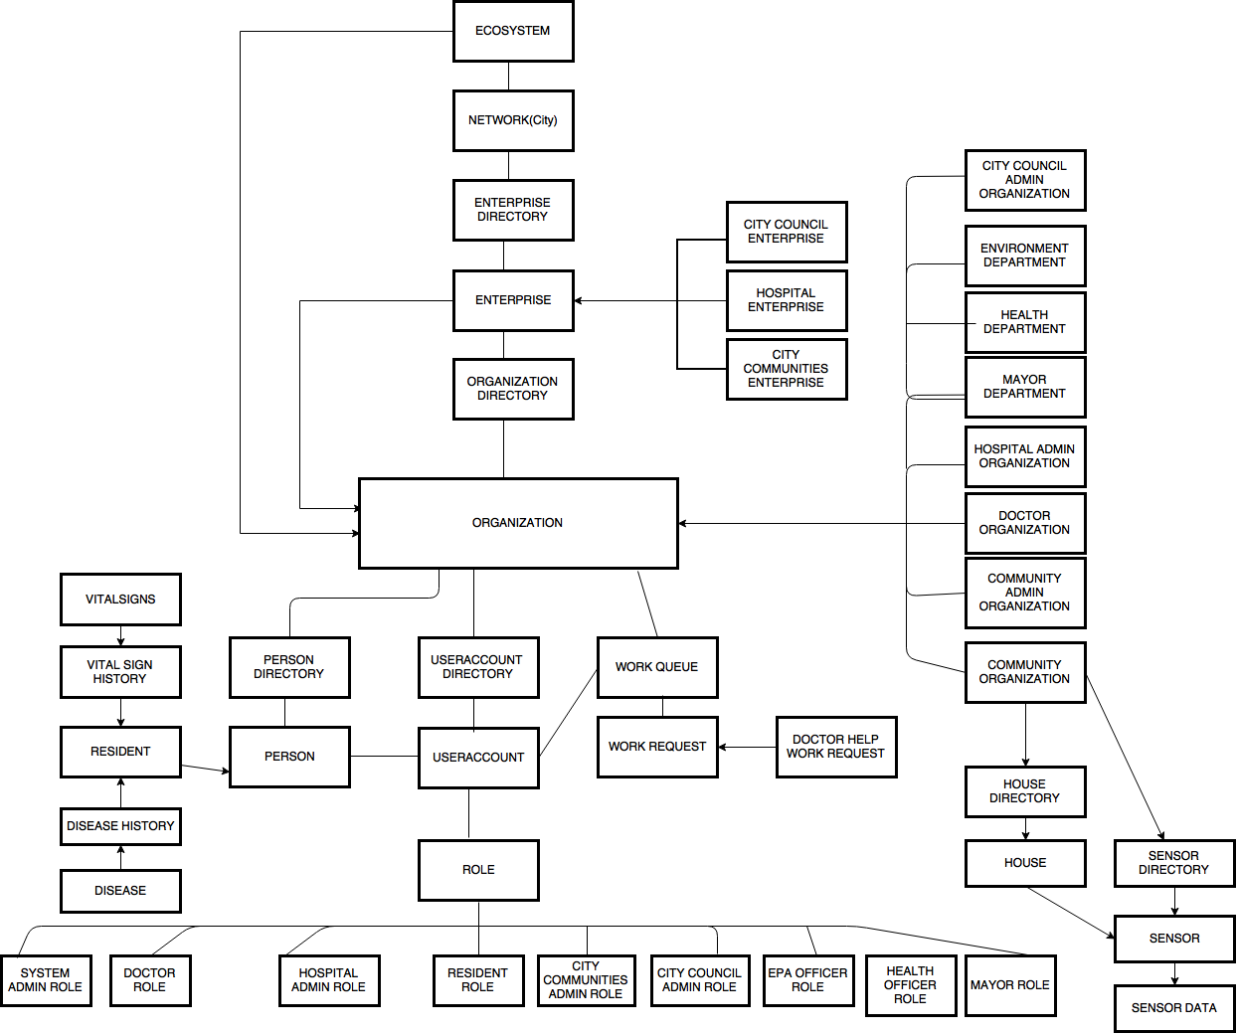

Slide 5
Resident Role
Manage Vital signs (HR, RR, BP, Weight)
Manage Health Records (Disease History)
Seek Medical Help

Slide 6
Doctor Role
Provide Medical Advice to Resident
View Health History of Resident seeking Help

Slide 7
EPA Role
View day-to-day AQI data and Analyze it
Report to Mayor
Notify Residents of a community in case of any issue
Provide assistance to Health Dept., if required.

Slide 8
Health Officer Role
View day-to-day Health issues for every community and analyze their data to predict any air related outbreak.
Report to Mayor
Seek assistance from Environmental Dept.

Slide 9
Mayor Role
View Summary of data from Health & Environment Dept. and analyze it.
Broadcast city wide message if required.
View daily updates from both the dept.

Slide 10
Key Features

Slide 11
Contd.

Slide 12
Extra Feature
Mayor can directly communicate with residents across the city with the use of E-Mail.
EPA officials can notify even a specific community in case of unhealthy air quality or any precaution needs to be taken care by its residents.

